Slide 1
Financial forecasting for stock market
Ishan Lalitkumar Patel
Ishan Hitendra Kumar Patel
Abhishek Raval

Slide 2
Financial stock prediction
Forecasting, whether the price of stock will increase or decrease, is a difficult task.
We try to predict the whether the stock would underperform or outperform based on the fluctuations of features in dataset till previous day.
The proposed solution will provide a benchmark to stock buyers to obtain maximum profit based on previous day fluctuations in the stock prices.

Slide 3
Dataset
In the financial markets, genetic algorithms are most commonly used to find the best combination values of parameters in a trading rule.
Earlier we decided to use Dow jones dataset of UC Irvine ML Repository, on which genetic algorithm is already used, and so we decided to use other algorithm
Now we are using free data provided by Yahoo Stocks
Our dataset contains 35 features
We have selected 20 best features out of 35 features of dataset with the help of f_classif which is default score function in Scikit which only works with classification tasks

Slide 4
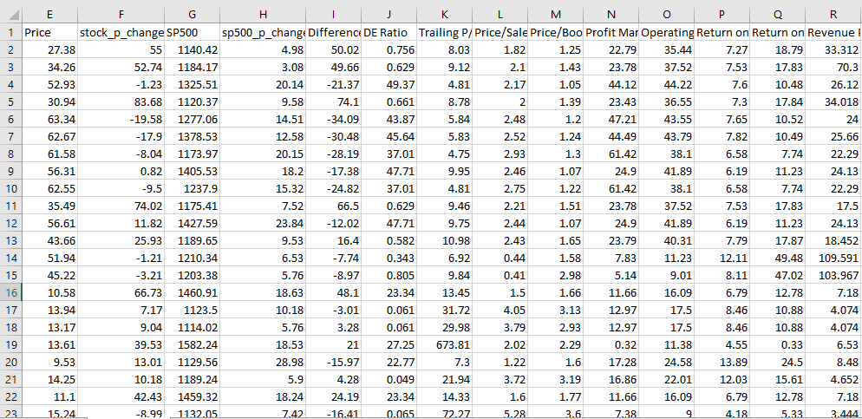
Dataset
Price, Profit Margin, Operating Margin, Return on Assets, Return on Equity, Revenue Per Share, Market Cap, Enterprise Value, Revenue, Gross Profit, Net Income Avl to Common , Earnings Growth, Revenue Growth, Total Cash, Total Cash Per Share, Total Debt, Current Ratio, Book Value Per Share, Cash Flow, Beta, Held by Insiders, Held by Institutions, Shares Short (as of, Short Ratio, Short % of Float, etc

Slide 5
Our approaches
We chose following 3 Algorithms for prediction :-
Random Forest (Random Decision Forest)
SVM (Support Vector Machine)
Neural Networks
Other Algorithms which can be used are :-
K Nearest Neighbour
Naïve Bayes
Hidden Markov Model

Slide 6
Dataset(input)
Variable selection
Training File
date,open,high,low,close,volume,percent_change_price,percent_change_volume_over_last_wk
1,AA,1/7/2011,$15.82,$16.72,$15.78,$16.42,239655616,3.79267,,
1,AA,1/14/2011,$16.71,$16.71,$15.64,$15.97,242963398,-4.42849,
Test Dataset
Prediction Algorithm
Training Data
Classification Algorithm
Ranking
Performance Curve
Performance Curve
ROC/AUC
Error Analysis
Error Analysis

Slide 7
Random Forest
Positive stock change
All stock prices (potential splitters)
Relevant stock change
stock prices (splitter)
Variable
Entire Stock dataset
A
A
C
E
B
D
F
G
H
I
Random subsample (2/3 of original): used to build tree
Random subsample (1/3 of original): used to “internally” validate tree
Random subsamples of stock prices
C
Best
Splitter
C
C
B
D
Accuracy of classifier estimated
F
Best
Splitter
F
F
G
H
Notes:
At the creation of each tree, a random subsample of the total data set is selected to grow the tree. At each node of the tree, a well-performing gene from a random subset of all genes is chosen as a “splitter variable”. The splitter variable attempts to separate patients in one class (e.g., Response) from those in the other class (e.g., Non-Response). The tree is grown with additional splitter variables until all terminal nodes (leaves) of the tree are purely one class or the other. This tree is then “tested” against the 1/3 of patients set aside, the “out of bag” (OOB) patients. Each OOB patient traverses the tree, going down one branch or another depending on his/her gene expression values for each splitter variable. These OOB patients are assigned a predicted class based on where they land in the tree (a vote). The entire process is repeated with new random divisions into 2/3 and 1/3 patient sets and new random gene sets for selection of splitter variables to produce additional trees and ultimately a forest. In each case a different subset of patients is used to build the tree and test its performance. At the end, each patient will have contributed to the construction of ~2/3 of all trees and been tested in the other ~1/3. Each “test” tree gives a vote for whether the patient will relapse or not relapse. The fraction of votes for relapse is an estimate of the probability of relapse and all patients will be predicted as either a relapse or non-relapse (using probability of 0.5 as the threshold). By comparing these predictions based on the OOB data to their known class, estimates of the accuracy of the overall forest can be obtained. The forest can then also be applied to independent test data or patients of unknown class (see next slide).

Slide 8
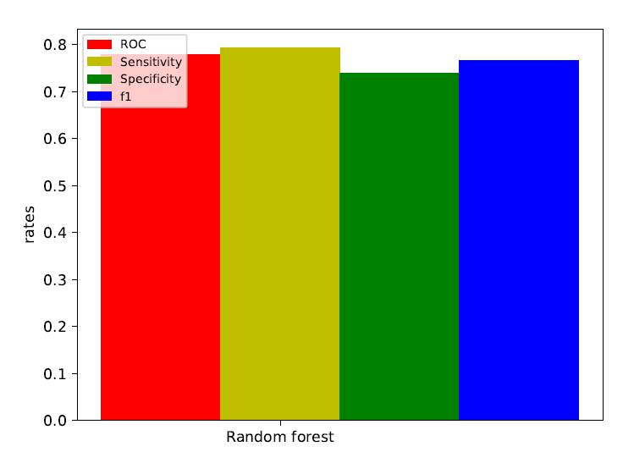
Accuracy: 0.758389261745 Precision: 0.785714285714 Recall: 0.785714285714 F1: 0.785714285714

Slide 9
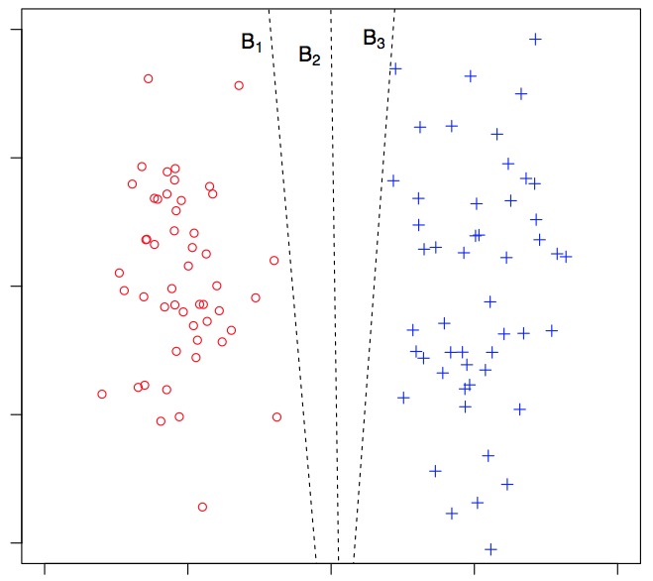
Support Vector Machine
Support Vector Machine
Numerical optimization
Finds best separating
hyper plane in
high-dimensional space
+ Recognizes complex
patterns
+ Guarantees wide margin
– Slow tuning by cross-validation

Slide 10
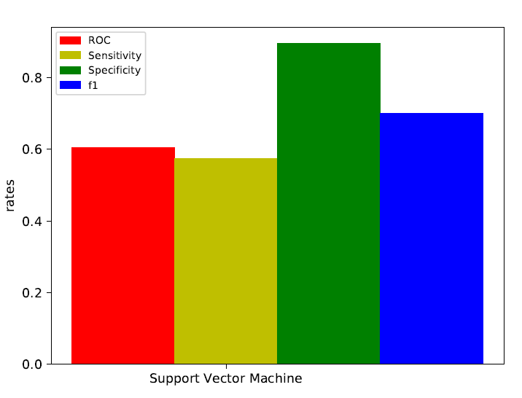
Accuracy:0.624161073826 Precision:0.627272727273 Recall:0.821428571429 F1:0.711340206186

Slide 11
ARTIFICIAL NEURAL NETWORK
Algorithm
In this case all connections are associated with weights.
Weighted sum is given is given to each nodes of the next layer which calculates sigmoid function.
On receiving the output from the output node , it is compared with the expected value and the output error is calculated.
This value of error propagated back into network to adjust the weights.
o
H₁
H₂
H₃
H₄
I₁
I_{n}

Slide 12
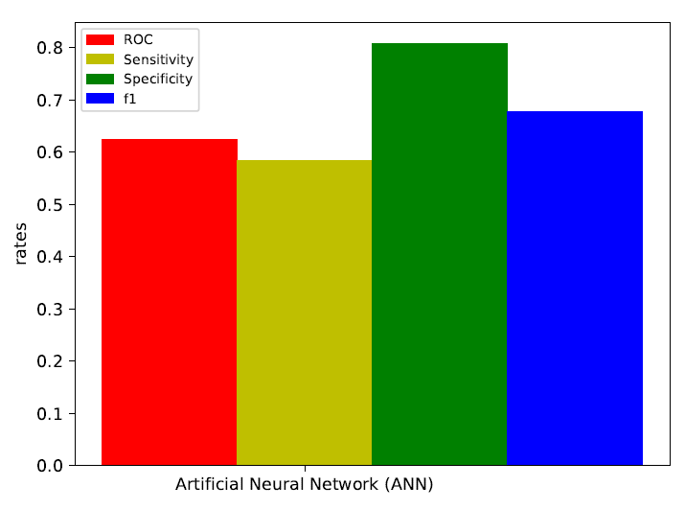
Accuracy:0.624161073826 Precision:0.584158415842 Recall:0.808219178082 F1:0.67816091954

Slide 13
Conclusion
Deterministic Datasets where changes are evitable and frequent, Random Forest predicts with higher accuracy.

Slide 14
SUGGESTED Future Improvements
Number of trees should be chosen by multiple manual iterations
Number of neuron should be chosen by formula : number of samples * n ; where n is number of middle layer neurons
Vector Machine is not always linear in the nature so we have to find multiple vector machines for a given problem which is most optimal

Slide 15
rEFERENCES
Dynamic-Radius Species-Conserving Genetic Algorithm for the Financial Forecasting of Dow Jones Index Stocks Michael Scott Brown, Michael J. Pelosi, and Henry Dirska
https://finance.yahoo.com/most-active
https://en.wikipedia.org/
http://scikit-learn.org/stable/modules/tree.html
http://scikit-learn.org/stable/auto_examples/tree/plot_tree_regression.html
http://scikit-learn.org/stable/modules/svm.html
https://matplotlib.org/
https://scikit-neuralnetwork.readthedocs.io/en/latest/
http://scikit-learn.org/stable/modules/neural_networks_supervised.html
https://www.investopedia.com/articles/financial-theory/11/using-genetic-algorithms-forecast-financial-markets.asp

Slide 16
Thank You

